Slide 1
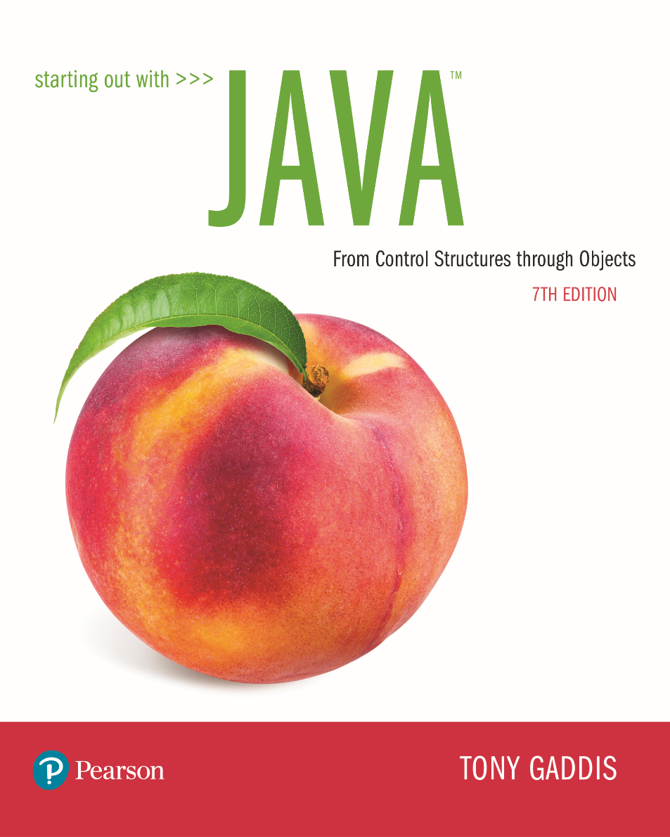

Slide 2
Examples’ Source Code
Source Code for examples presented in these slides can be found on:
Blackboard->Course Content->Source Code Of The Book Examples

Slide 3
Module 1 Topics
Chapter 1
Introduction to Java
1.6 The Programming Process
1.7 Object-Oriented Programming
Chapter 2
2.1 The Parts of a Java Program 2.2 The print and println Methods, and the Java API 2.3 Variables and Literals 2.4 Primitive Data Types 2.5 Arithmetic Operators 2.6 Combined Assignment Operators
2.7 Conversion between Primitive Data Types
2.8 Creating Named Constants with final
2.9 The string Class
2.10 Scope
2.11 Comments
2.12 Programming Style
2.13 Reading Keyboard Input
Code Coverage (Testing)

Slide 4
Java History
1991 - Green Team started by Sun Microsystems.
There was a need for a programming language that would run on various devices.
Java (first named Oak) was developed for this purpose.

Slide 5
Introduction
Java enabled web browser (HotJava) demonstrated at 1995 Sun World conference.
Java incorporated into Netscape shortly after.
Java is “cross platform”, meaning that it can run on various computer operating systems.

Slide 6
Java Applications and Applets
Java programs can be of two types:
Applications
Stand-alone programs that run without the aid of a web browser.
Relaxed security model since the user runs the program locally.
Applets
Small applications that require the use of a Java enabled web browser to run.
Enhanced security model since the user merely goes to a web page and the applet runs itself.

Slide 7
The Compiler and the Java Virtual Machine
A programmer writes Java programming statements for a program.
These statements are known as source code.
A text editor is used to edit and save a Java source code file.
Source code files have a .java file extension.
A compiler is a program that translates source code into an executable form.

Slide 8
The Compiler and the Java Virtual Machine
A compiler is run using a source code file as input.
Syntax errors that may be in the program will be discovered during compilation.
Syntax errors are mistakes that the programmer has made that violate the rules of the programming language.
The compiler creates another file that holds the translated instructions.

Slide 9
The Compiler and the Java Virtual Machine
Most compilers translate source code into executable files containing machine code.
The Java compiler translates a Java source file into a file that contains byte code instructions.
Byte code instructions are the machine language of the Java Virtual Machine (JVM) and cannot be directly executed directly by the CPU.

Slide 10
The Compiler and the Java Virtual Machine
Byte code files end with the .class file extension.
The JVM is a program that emulates a micro-processor.
The JVM executes instructions as they are read.
JVM is often called an interpreter.
Java is often referred to as an interpreted language.

Slide 11
Program Development Process
Text editor
Saves Java statements
Source code
(.java)
Is read by
Byte code (.class)
Java compiler
Produces
Is interpreted by
Program
Execution
Java
Virtual
Machine
Results in

Slide 12
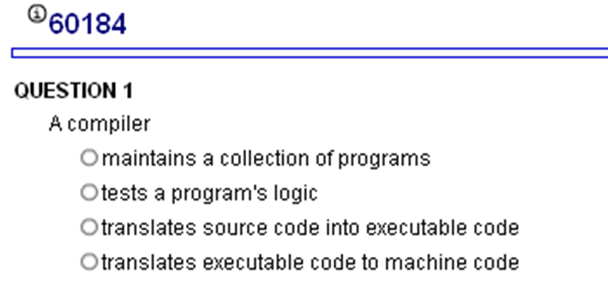
My Programming Lab 1 – 1.5

Slide 13
Portability
Portable means that a program may be written on one type of computer and then run on a wide variety of computers, with little or no modification.
Java byte code runs on the JVM and not on any particular CPU; therefore, compiled Java programs are highly portable.
JVMs exist on many platforms:
Windows
Mac
Linux
Unix
BSD
Etc.

Slide 14
Portability
With most programming languages, portability is achieved by compiling a program for each CPU it will run on.
Java provides an JVM for each platform so that programmers do not have to recompile for different platforms.

Slide 15
Portability
Byte code (.class)
Java Virtual
Machine for Windows
Java Virtual
Machine for Unix
Java Virtual
Machine for Linux
Java Virtual
Machine for Mac

Slide 16
Java Versions
The software you use to write Java programs is called the Java Development Kit, or JDK.
There are different editions of the JDK:
Java SE - Java2 Standard Edition.
Java EE - Java2 Enterprise Edition.
Java ME - Java2 Micro Edition.
Available for download at http://java.oracle.com

Slide 17
The Programming Process
1. Clearly define what the program is to do.
2. Visualize the program running on the computer.
3. Use design tools to create a model of the program.
4. Check the model for logical errors.
5. Enter the code and compile it.
6. Correct any errors found during compilation (syntax errors).
Repeat Steps 5 and 6 as many times as necessary.
7. Run the program with test data for input.
8. Correct any runtime errors found while running the program.
Repeat Steps 5 through 8 as many times as necessary.
9. Validate the results of the program.

Slide 18
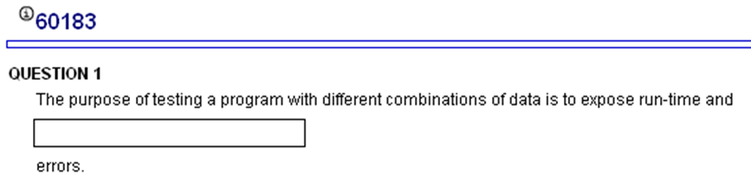
My Programming Lab 1 – 1.6

Slide 19
Software Engineering
Encompasses the whole process of crafting computer software.
Software engineers perform several tasks in the development of complex software projects.
designing,
writing,
testing,
debugging,
documenting,
modifying, and
maintaining.

Slide 20
Software Engineering
Software engineers develop:
program specifications,
diagrams of screen output,
diagrams representing the program components and the flow of data,
pseudocode,
examples of expected input and desired output.

Slide 21
Software Engineering
Software engineers also use special software designed for testing programs (JUnit tests).
Most commercial software applications are large and complex.
Usually a team of programmers, not a single individual, develops them.
Program requirements are thoroughly analyzed and divided into subtasks that are handled by
individual teams
individuals within a team.

Slide 22
Procedural Programming
Older programming languages were procedural.
A procedure is a set of programming language statements that, together, perform a specific task.
Procedures typically operate on data items that are separate from the procedures.
In a procedural program, the data items are commonly passed from one procedure to another.

Slide 23
Procedural Programming
In procedural programming, procedures are developed to operate on the program’s data.
Data in the program tends to be global to the entire program.
Data formats might change and thus, the procedures that operate on that data must change.
Data Element
Procedure A
Procedure B

Slide 24
What is the basic building block for
Procedural programming?
Functions (procedures)
Data Element
Procedure A
Procedure B

Slide 25
Object-Oriented Programming
Object-oriented programming is centered on creating objects rather than procedures.
Objects are a melding of data and procedures that manipulate that data.
Data in an object are known as attributes.
Procedures in an object are known as methods.

Slide 26
Object-Oriented Programming
Object
Attributes (data)
Methods (behaviors / procedures)

Slide 27
Object-Oriented Programming
Object-oriented programming combines data and behavior via encapsulation.
Data hiding is the ability of an object to hide data from other objects in the program.
Only an objects methods should be able to directly manipulate its attributes.
Other objects are allowed manipulate an object’s attributes via the object’s methods.
This indirect access is known as a programming interface.

Slide 28
Object-Oriented Programming
Object
Programming
Interface
Attributes (data)
Methods (behaviors / procedures)
Other
objects

Slide 29

Object-Oriented Programming
Object
Attributes (data)
Methods (behaviors / procedures)
Other
objects

Slide 30
What is the basic building block for
Object oriented programming?
Object
Objects
Attributes (data)
Methods (behaviors / procedures)

Slide 31
Data Element
Procedure A
Procedure B
Object
Attributes (data)
Data is separate from procedures
Methods (behaviors / procedures)
Data is encapsulated
with procedures

Slide 32
Parts of a Java Program
A Java source code file contains one or more Java classes.
If more than one class is in a source code file, only one of them may be public.
The public class and the filename of the source code file must match.
ex: A class named Simple must be in a file named Simple.java
Each Java class can be separated into parts.

Slide 33
Simple.java
// This is a simple Java program
public class Simple
{
public static void main(String[] args)
{
System.out.println(“Programming is great fun!”);
}
}

Slide 34
Analyzing The Example
// This is a simple Java program.
This is a Java comment. It is ignored by the compiler.
public class Simple { }
This is the class header for the class Simple
This area is the body of the class Simple.
All of the data and methods for this class will be between these curly braces.

Slide 35
Analyzing The Example
This is the method header
for the main method. The
main method is where a Java
application begins.
// This is a simple Java program.
public class Simple { }
public static void main(String[] args)
{
}
This area is the body of the main method.
All of the actions to be completed during
the main method will be between these curly braces.

Slide 36
Analyzing The Example
// This is a simple Java program.
public class Simple { }
public static void main(String [] args) {
System.out.println("Programming is great fun!"); }
This is the Java Statement that is executed when the program runs.

Slide 37
Parts of a Java Program
Comments
The line is ignored by the compiler.
The comment in the example is a single-line comment.
Class Header
The class header tells the compiler things about the class such as what other classes can use it (public) and that it is a Java class (class), and the name of that class (Simple).
Curly Braces
When associated with the class header, they define the scope of the class.
When associated with a method, they define the scope of the method.

Slide 38
Parts of a Java Program
The main Method
This line must be exactly as shown in the example (except the args variable name can be programmer defined).
This is the line of code that the java command will run first.
This method starts the Java program.
Every Java application must have a main method.
Java Statements
When the program runs, the statements within the main method will be executed.

Slide 39
Java Statements
If we look back at the previous example, we can see that there is only one line that ends with a semi-colon.
System.out.println("Programming is great fun!");
This is because it is the only Java statement in the program.
The rest of the code is either a comment or other Java framework code.

Slide 40
Java Statements
Comments are ignored by the Java compiler so they need no semi-colons.
Other Java code elements that do not need semi colons include:
class headers
Terminated by the code within its curly braces.
method headers
Terminated by the code within its curly braces.
curly braces
Part of framework code that needs no semi-colon termination.

Slide 41
Short Review
Java is a case-sensitive language.
All Java programs must be stored in a file with a .java file extension.
Comments are ignored by the compiler.
A .java file may contain many classes but may only have one public class.
If a .java file has a public class, the class must have the same name as the file.

Slide 42
Short Review
Java applications must have a main method.
For every left brace, or opening brace, there must be a corresponding right brace, or closing brace.
Statements are terminated with semicolons.
Comments, class headers, method headers, and braces are not considered Java statements.

Slide 43
Special Characters
// | double slash | Marks the beginning of a single line comment.
( ) | open and close parenthesis | Used in a method header to mark the parameter list.
{ } | open and close curly braces | Encloses a group of statements, such as the contents of a class or a method.
“ ” | quotation marks | Encloses a string of characters, such as a message that is to be printed on the screen
; | semi-colon | Marks the end of a complete programming statement

Slide 44
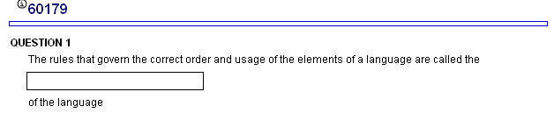
My Programming Lab 1 – 1.5

Slide 45
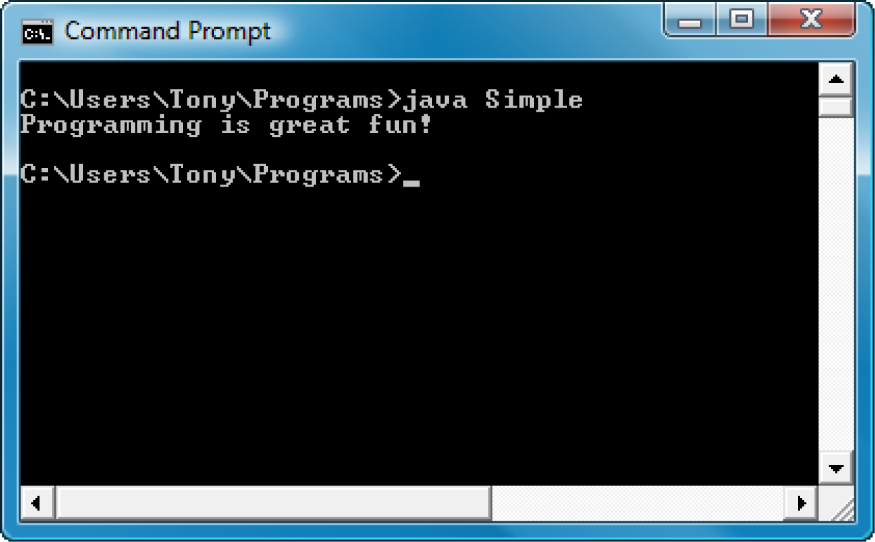
Console Output
Many of the programs that you will write can run in a console window.

Slide 46
Parts of a Java Program
To compile the example:
javac Simple.java
Notice the .java file extension is needed.
This will result in a file named Simple.class being created.
To run the example:
java Simple
Notice there is no file extension here.
The java command assumes the extension is .class.

Slide 47
Compiling a Java Program – command line
The Java compiler is a command line utility.
The command to compile a program is:
javac filename.java
javac is the Java compiler.
The .java file extension must be used.
Example: To compile a java source code file named Payroll.java you would use the command:
javac Payroll.java

Slide 48
Console Output
The console window that starts a Java application is typically known as the standard output device.
The standard input device is typically the keyboard.
Java sends information to the standard output device by using a Java class stored in the standard Java library.

Slide 49
Console Output
Java classes in the standard Java library are accessed using the Java Applications Programming Interface (API).
The standard Java library is commonly referred to as the Java API.

Slide 50
Console Output
The previous example uses the line:
System.out.println("Programming is great fun!");
This line uses the System class from the standard Java library.
The System class contains methods and objects that perform system level tasks.
The out object, a member of the System class, contains the methods print and println.

Slide 51
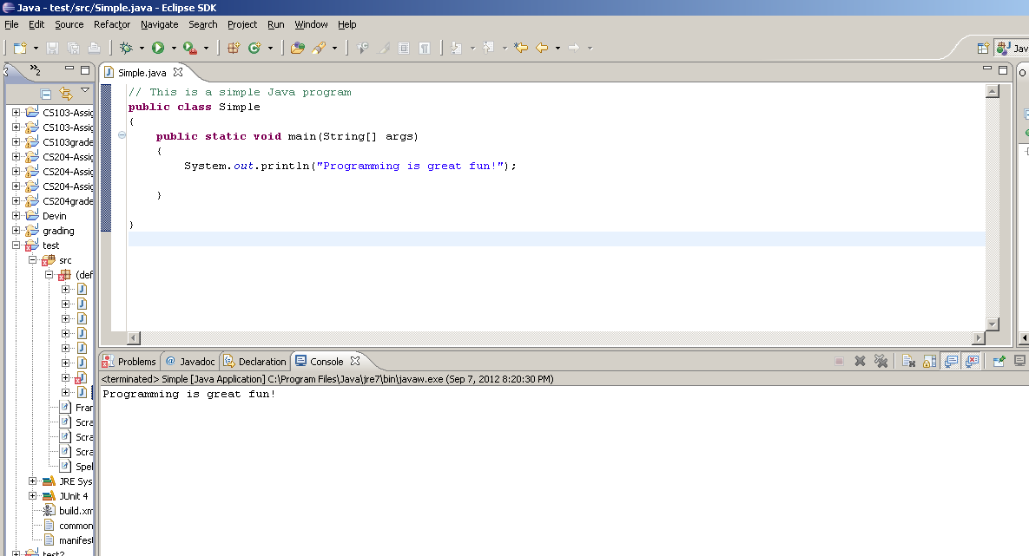
Compiling a Java Program – IDE
… or in a IDE (Integrated Development Environment), such as Eclipse

Slide 52

The Structure of a Simple Program: Method Call
System.out.println(“Programming is great fun!");
is a method call
A method call requires:
The object that you want to use (in this case, System.out)
The name of the method you want to use (in this case, println)
Parameters enclosed in parentheses (()) containing any other
information the method needs (in this case, “Programming is great fun!")
System.out.println(“Programming is great fun!");

Slide 53
The Structure of a Simple Program:
Methods print and println
The print and println methods actually perform the task of sending characters to the output device.
The line:
System.out.println("Programming is great fun!");
is pronounced: System dot out dot println …
The value inside the parenthesis will be sent to the output device (in this case, a string).

Slide 54
The Structure of a Simple Program: Method println
The println method places a newline character at the end of whatever is being printed out.
The following lines:
System.out.println("This is being printed out");
System.out.println("on two separate lines.");
Would be printed out on separate lines since the first statement sends a newline command to the screen.

Slide 55
The Structure of a Simple Program: Method print
However, the print statement does not put a newline character at the end of the output.
The lines:
System.out.print("These lines will be");
System.out.print("printed on");
System.out.println("the same line.");
Will output: These lines will beprinted onthe same line.
There are some special characters that can be put into the output. System.out.print("This line will have a newline at the end.\n");
The \n in the string is an escape sequence that represents the newline character.
Escape sequences allow the programmer to print characters that otherwise would be unprintable.

Slide 56
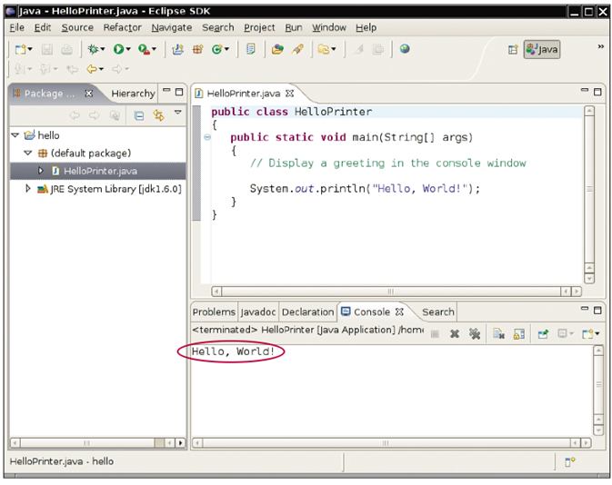

HelloPrinter in an IDE
TRY IT!

Slide 57
Java Escape Sequences
\n | newline | Advances the cursor to the next line for subsequent printing
\t | tab | Causes the cursor to skip over to the next tab stop
\b | backspace | Causes the cursor to back up, or move left, one position
\r | carriage return | Causes the cursor to go to the beginning of the current line, not the next line
\\ | backslash | Causes a backslash to be printed
\’ | single quote | Causes a single quotation mark to be printed
\” | double quote | Causes a double quotation mark to be printed

Slide 58
Java Escape Sequences
Even though the escape sequences are comprised of two characters, they are treated by the compiler as a single character.
System.out.print("These are our top sellers:\n");
System.out.print("\tComputer games\n\tCoffee\n ");
System.out.println("\tAspirin");
Would result in the following output:
These are our top seller:
Computer games
Coffee
Asprin
With these escape sequences, complex text output can be achieved.

Slide 59
Java API
Java classes in the standard Java library are accessed using the Java Applications Programming Interface (API).
The standard Java library is commonly referred to as the Java API.

Slide 60
Variables and Literals
A variable is a named storage location in the computer’s memory.
A literal is a value that is written into the code of a program.
Programmers determine the number and type of variables a program will need

Slide 61
Variables and Literals
This line is called
a variable declaration.
int value;
The following line is known
as an assignment statement.
value = 5;
0x000
The value 5
is stored in
memory.
0x001
5
0x002
0x003
This is a string literal. It will be printed as is.
System.out.print("The value is ");
System.out.println(value);
The integer 5 will
be printed out here.
Notice no quote marks?

Slide 62
The + Operator
The + operator can be used in two ways.
as a concatenation operator
as an addition operator
If either side of the + operator is a string, the result will be a string.
System.out.println("Hello " + "World");
System.out.println("The value is: " + 5);
System.out.println("The value is: " + value);
System.out.println("The value is: " + ‘/n’ + 5);

Slide 63
String Concatenation
The String concatenation operator can be used to join strings.
System.out.println("These lines are " +
"are now ok and will not " +
"cause the error as before.");
String concatenation can join various data types.
System.out.println("We can join a string to " +
"a number like this: " + 5);

Slide 64
String Concatenation
The Concatenation operator can be used to format complex String objects.
System.out.println("The following will be printed " +
"in a tabbed format: " +
\n\tFirst = " + 5 * 6 + ", " +
"\n\tSecond = " (6 + 4) + "," +
"\n\tThird = " + 16.7 + ".");
Notice that if an addition operation is also needed, it must be put in parenthesis.

Slide 65
Identifiers
Identifiers are programmer-defined names for:
classes
variables
methods
Identifiers may not be any of the Java reserved keywords.

Slide 66
Identifiers
Identifiers must follow certain rules:
An identifier may only contain:
letters a–z or A–Z,
the digits 0–9,
underscores (_), or
the dollar sign ($)
The first character may not be a digit.
Identifiers are case sensitive.
itemsOrdered is not the same as itemsordered.
Identifiers cannot include spaces.
Cannot be a keyword

Slide 67
Java Reserved Keywords
abstract
assert
boolean
break
byte
case
catch
char
class
const
continue
default
do
double
else
enum
extends
false
for
final
finally
float
goto
if
implements
import
instanceof
int
interface
long
native
new
null
package
private
protected
public
return
short
static
strictfp
super
switch
synchronized
this
throw
throws
transient
true
try
void
volatile
while

Slide 68
Variable Names
Variable names should be descriptive.
Descriptive names allow the code to be more readable; therefore, the code is more maintainable.
Which of the following is more descriptive?
double tr = 0.0725;
double salesTaxRate = 0.0725;
Java programs should be self-documenting.

Slide 69
Java Naming Conventions
Variable names should begin with a lower case letter and then switch to title case thereafter:
Ex: int caTaxRate
Class names should begin with a upper case letter.
Ex: public class BigLittle
More Java naming conventions can be found at:
http://java.sun.com/docs/codeconv/html/CodeConventions.doc8.html
A general rule of thumb about naming variables and classes are that, with some exceptions, their names tend to be nouns or noun phrases.

Slide 70
Primitive Data Types
Primitive data types are built into the Java language and are not derived from classes.
There are 8 Java primitive data types.
byte
short
int
long
float
double
boolean
char

Slide 71
Numeric Data Types
byte | 1 byte | Integers in the range -128 to +127
short | 2 bytes | Integers in the range of -32,768 to +32,767
int | 4 bytes | Integers in the range of -2,147,483,648 to +2,147,483,647
long | 8 bytes | Integers in the range of -9,223,372,036,854,775,808 to +9,223,372,036,854,775,807
float | 4 bytes | Floating-point numbers in the range of ±3.410-38 to ±3.41038, with 7 digits of accuracy
double | 8 bytes | Floating-point numbers in the range of ±1.710-308 to ±1.710308, with 15 digits of accuracy

Slide 72
Variable Declarations
Variable Declarations take the following form:
DataType VariableName;
byte inches;
short month;
int speed;
long timeStamp;
float salesCommission;
double distance;

Slide 73
Integer Data Types
byte, short, int, and long are all integer data types.
They can hold whole numbers such as 5, 10, 23, 89, etc.
Integer data types cannot hold numbers that have a decimal point in them.
Integers embedded into Java source code are called integer literals.
See Example: IntegerVariables.java

Slide 74
Floating Point Data Types
Data types that allow fractional values are called floating-point numbers.
1.7 and -45.316 are floating-point numbers.
In Java there are two data types that can represent floating-point numbers.
float - also called single precision (7 decimal points).
double - also called double precision (15 decimal points).

Slide 75
Floating Point Literals
When floating point numbers are embedded into Java source code they are called floating point literals.
The default type for floating point literals is double.
29.75, 1.76, and 31.51 are double data types.
Java is a strongly-typed language.
See example: Sale.java

Slide 76
Floating Point Literals
A double value is not compatible with a float variable because of its size and precision.
float number;
number = 23.5; // Error!
A double can be forced into a float by appending the letter F or f to the literal.
float number;
number = 23.5F; // This will work.

Slide 77
Floating Point Literals
Literals cannot contain embedded currency symbols or commas.
grossPay = $1,257.00; // ERROR!
grossPay = 1257.00; // Correct.
Floating-point literals can be represented in scientific notation.
47,281.97 == 4.728197 x 10⁴.
Java uses E notation to represent values in scientific notation.
4.728197X10⁴ == 4.728197E4.

Slide 78
Scientific and E Notation
Decimal Notation | Scientific Notation | E Notation
247.91 | 2.4791 x 10² | 2.4791E2
0.00072 | 7.2 x 10⁻⁴ | 7.2E-4
2,900,000 | 2.9 x 10⁶ | 2.9E6

Slide 79
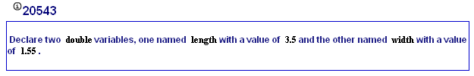
My Programming Lab 1 – 2.4 init

Slide 80
The boolean Data Type
The Java boolean data type can have two possible values.
true
false
The value of a boolean variable may only be copied into a boolean variable.
See example: TrueFalse.java

Slide 81
The char Data Type
The Java char data type provides access to single characters.
char literals are enclosed in single quote marks.
‘a’, ‘Z’, ‘\n’, ‘1’
Don’t confuse char literals with string literals.
char literals are enclosed in single quotes.
String literals are enclosed in double quotes.
See example: Letters.java

Slide 82
Unicode
Internally, characters are stored as numbers.
Character data in Java is stored as Unicode characters.
The Unicode character set can consist of 65536 (2¹⁶) individual characters.
This means that each character takes up 2 bytes in memory.
The first 256 characters in the Unicode character set are compatible with the ASCII* character set.
See example: Letters2.java
*American Standard Code for Information Interchange

Slide 83
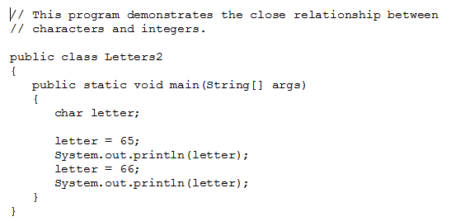

Slide 84
Unicode
A
B
00
65
00
66
0
0
0
0
0
0
0
0
0
1
0
0
0
0
0
1
0
0
0
0
0
0
0
0
0
1
0
0
0
0
1
1

Slide 85
Unicode
A
Characters are
stored in memory as binary numbers.
B
00
65
00
66
0
0
0
0
0
0
0
0
0
1
0
0
0
0
0
1
0
0
0
0
0
0
0
0
0
1
0
0
0
0
1
1

Slide 86
Unicode
A
The binary numbers
represent these
decimal values.
B
00
65
00
66
0
0
0
0
0
0
0
0
0
1
0
0
0
0
0
1
0
0
0
0
0
0
0
0
0
1
0
0
0
0
1
1

Slide 87
Unicode
A
B
00
65
The decimal values
represent these
characters.
00
66
0
0
0
0
0
0
0
0
0
1
0
0
0
0
0
1
0
0
0
0
0
0
0
0
0
1
0
0
0
0
1
1

Slide 88
Variable Assignment and Initialization
In order to store a value in a variable, an assignment statement must be used.
The assignment operator is the equal (=) sign.
The operand on the left side of the assignment operator must be a variable name.
The operand on the right side must be either a literal or expression that evaluates to a type that is compatible with the type of the variable.

Slide 89
Variable Assignment and Initialization
// This program shows variable assignment. public class Initialize { public static void main(String[] args) { int month, days; month = 2; days = 28; System.out.println("Month " + month + " has " + days + " Days."); }
}
The variables must be declared before they can be used.

Slide 90
Variable Assignment and Initialization
// This program shows variable assignment. public class Initialize { public static void main(String[] args) { int month, days; month = 2; days = 28; System.out.println("Month " + month + " has " + days + " Days."); }
}
Once declared, they can then receive a value (initialization);
however the value must be compatible with the variable’s
declared type.

Slide 91
Variable Assignment and Initialization
// This program shows variable assignment. public class Initialize { public static void main(String[] args) { int month, days; month = 2; days = 28; System.out.println("Month " + month + " has " + days + " Days."); }
}
After receiving a value, the variables can then be used in
output statements or in other calculations.

Slide 92
Variable Assignment and Initialization
// This program shows variable initialization. public class Initialize { public static void main(String[] args) { int month = 2, days = 28;
System.out.println("Month " + month + " has " + days + " Days."); }
}
Local variables can be declared and initialized on
the same line.

Slide 93
Variable Assignment and Initialization
Variables can only hold one value at a time.
Local variables do not receive a default value.
Local variables must have a valid type in order to be used.
public static void main(String [] args) { int month, days; //No value given…
System.out.println("Month " + month + " has " + days + " Days."); } Trying to use uninitialized variables will generate a Syntax Error when the code is compiled.

Slide 94
Arithmetic Operators
Java has five (5) arithmetic operators.
Operator | Meaning | Type | Example
+ | Addition | Binary | total = cost + tax;
- | Subtraction | Binary | cost = total – tax;
* | Multiplication | Binary | tax = cost * rate;
/ | Division | Binary | salePrice = original / 2; **Integer division
% | Modulus | Binary | remainder = value % 5;

Slide 95
Arithmetic Operators
The operators are called binary operators because they must have two operands.
Each operator must have a left and right operator.
See example: Wages.java
The arithmetic operators work as one would expect.
It is an error to try to divide any number by zero.
When working with two integer operands, the division operator requires special attention.

Slide 96
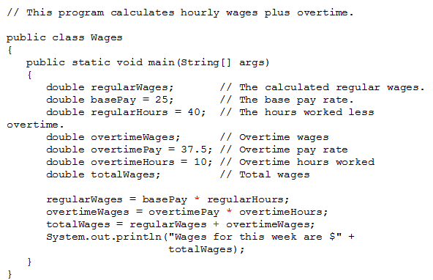

Slide 97
Integer Division
Division can be tricky.
In a Java program, what is the value of 1/2?
You might think the answer is 0.5…
But, that’s wrong.
The answer is simply 0.
Integer division will truncate any decimal remainder.

Slide 98
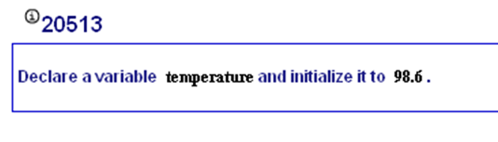
My Programming Lab 1 – 2.4 which type

Slide 99
Operator Precedence
Mathematical expressions can be very complex.
There is a set order in which arithmetic operations will be carried out.
Change precedence with parenthesis
Operator | Associativity | Example | Result
- (unary negation) | Right to left | x = -4 + 3; | -1
* / % | Left to right | x = -4 + 4 % 3 * 13 + 2; | 11
+ - | Left to right | x = 6 + 3 – 4 + 6 * 3; | 23
Higher
Priority
Lower
Priority

Slide 100
Grouping with Parenthesis
When parenthesis are used in an expression, the inner most parenthesis are processed first.
If two sets of parenthesis are at the same level, they are processed left to right.
x = ((4*5) / (5-2) ) – 25; // result = -19
3
1
2
4

Slide 101
Combined Assignment Operators
Java has some combined assignment operators.
These operators allow the programmer to perform an arithmetic operation and assignment with a single operator.
Although not required, these operators are popular since they shorten simple equations.

Slide 102
Combined Assignment Operators
Operator | Example | Equivalent | Value of variable after operation
+= | x += 5; | x = x + 5; | The old value of x plus 5.
-= | y -= 2; | y = y – 2; | The old value of y minus 2
*= | z *= 10; | z = z * 10; | The old value of z times 10
/= | a /= b; | a = a / b; | The old value of a divided by b.
%= | c %= 3; | c = c % 3; | The remainder of the division of the old value of c divided by 3.

Slide 103

My Programming Lab 1 – 2.6

Slide 104
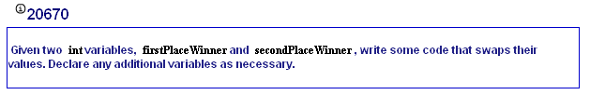
My Programming Lab 1 – 2.4 exchanges

Slide 105
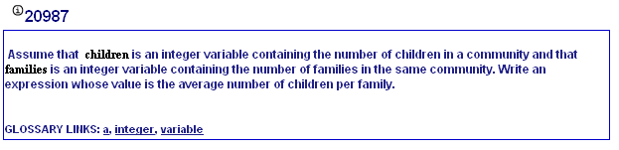
My Programming Lab 2 – 2.7

Slide 106
Creating Constants
Many programs have data that does not need to be changed.
Littering programs with literal values can make the program hard do read and maintain.
Replacing literal values with constants remedies this problem.
Constants allow the programmer to use a name rather than a value throughout the program.
Constants also give a singular point for changing those values when needed.

Slide 107
Creating Constants
Constants keep the program organized and easier to maintain.
Constants are identifiers that can hold only a single value.
Constants are declared using the keyword final.
Constants need not be initialized when declared; however, they must be initialized before they are used or a compiler error will be generated.

Slide 108
Creating Constants
Once initialized with a value, constants cannot be changed programmatically.
By convention, constants are all upper case and words are separated by the underscore character.
final int CAL_SALES_TAX = 0.725;

Slide 109
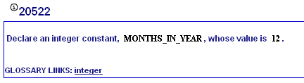
My Programming Lab 2 – 2.8

Slide 110
The String Class
Java has no primitive data type that holds a series of characters.
The String class from the Java standard library is used for this purpose.
In order to be useful, the a variable must be created to reference a String object.
String number;
Notice the S in String is upper case.
By convention, class names should always begin with an upper case character.

Slide 111
Primitive vs. Reference Variables
Primitive variables actually contain the value that they have been assigned.
number = 25;
The value 25 will be stored in the memory location associated with the variable number.
Objects are not stored in variables, however. Objects are referenced by variables.

Slide 112
Primitive vs. Reference Variables
When a variable references an object, it contains the memory address of the object’s location.
Then it is said that the variable references the object.
String cityName = "Charleston";
The object that contains the
character string “Charleston”
Charleston
cityName
Address to the object

Slide 113
String Objects
A variable can be assigned a String literal.
String value = "Hello";
Strings are the only objects that can be created in this way.
A variable can be created using the new keyword.
String value = new String("Hello");
This is the method that all other objects must use when they are created.
See example: StringDemo.java

Slide 114
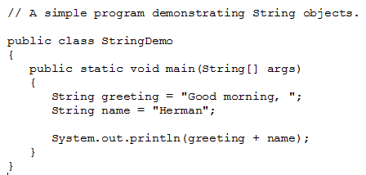

Slide 115

My Programming Lab 2 – 2.9

Slide 116
The String Methods
Since String is a class, objects that are instances of it have methods.
One of those methods is the length method.
stringSize = value.length();
This statement runs the length method on the object pointed to by the value variable.
See example: StringLength.java

Slide 117
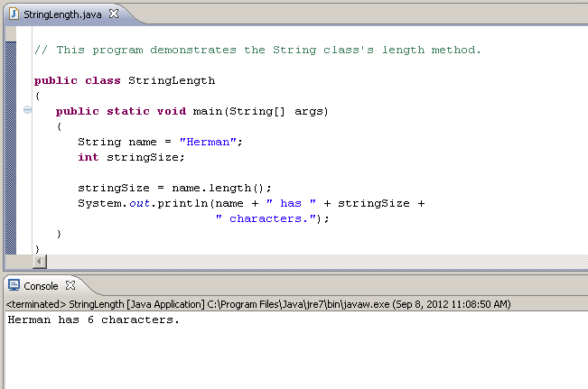

Slide 118
String Methods
The String class contains many methods that help with the manipulation of String objects.
String objects are immutable, meaning that they cannot be changed.
Many of the methods of a String object can create new versions of the object.
See example: StringMethods.java

Slide 119
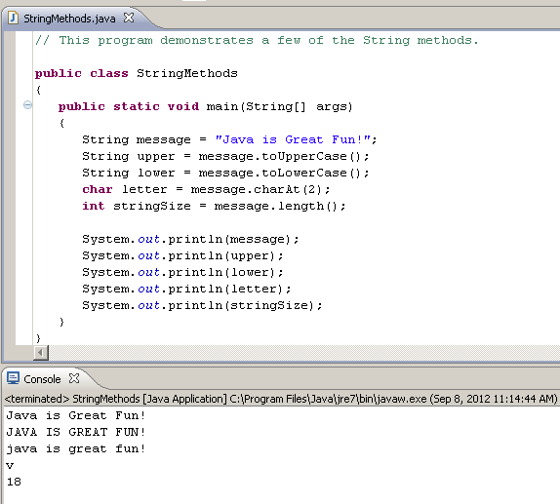

Slide 120
How would you find out which methods were available for a String object?

Slide 121
The API Documentation
API: Application Programming Interface
API documentation: lists classes and methods in the Java library
http://docs.oracle.com/javase/7/docs/api/

Slide 122
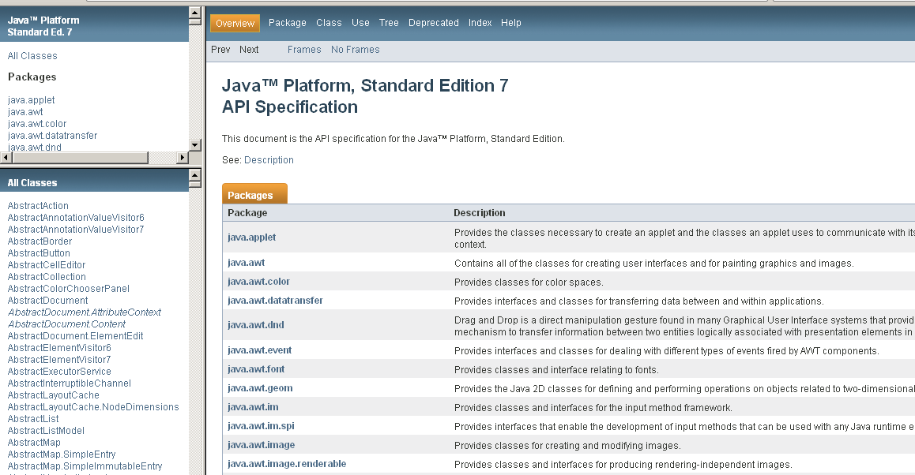
Scroll down and find String

Slide 123
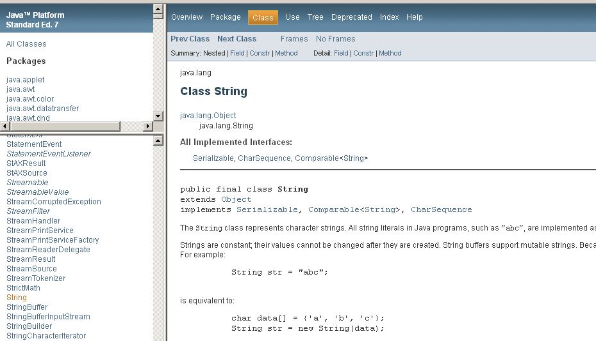
Scroll down to find methods

Slide 124
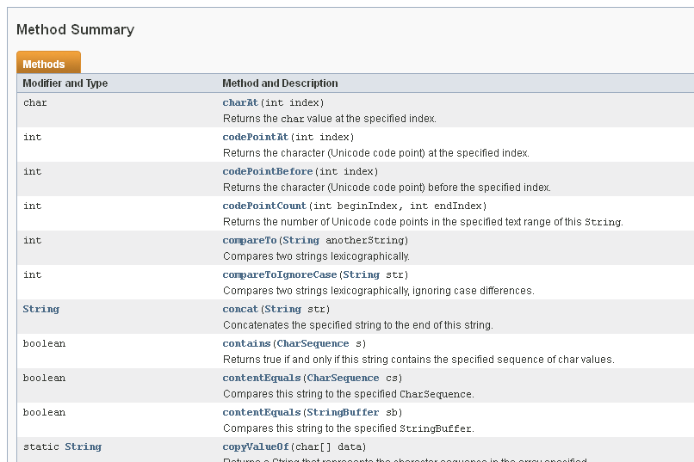

Slide 125
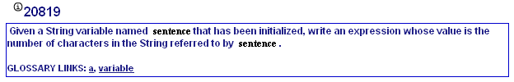
My Programming Lab 2 – 2.9

Slide 126
Scope
Scope refers to the part of a program that has access to a variable’s contents.
Variables declared inside a method (like the main method) are called local variables.
Local variables’ scope begins at the declaration of the variable and ends at the end of the method in which it was declared.
See example: Scope.java (This program contains an intentional error.)

Slide 127
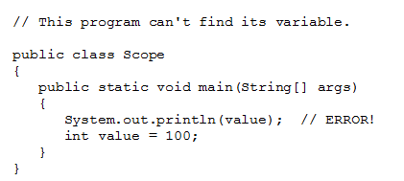

Slide 128
Commenting Code
Java provides three methods for commenting code.
Comment Style | Description
// | Single line comment. Anything after the // on the line will be ignored by the compiler.
/* … */ | Block comment. Everything beginning with /* and ending with the first */ will be ignored by the compiler. This comment type cannot be nested.
/** … */ | Javadoc comment. This is a special version of the previous block comment that allows comments to be documented by the javadoc utility program. Everything beginning with the /** and ending with the first */ will be ignored by the compiler. This comment type cannot be nested. This is covered in detail later.

Slide 129
Commenting Code – discussed in detail in Module 5
Javadoc comments can be built into HTML documentation.
See example: Comment3.java
To create the documentation:
Run the javadoc program with the source file as an argument
Ex: javadoc Comment3.java
The javadoc program will create index.html and several other documentation files in the same directory as the input file.

Slide 130
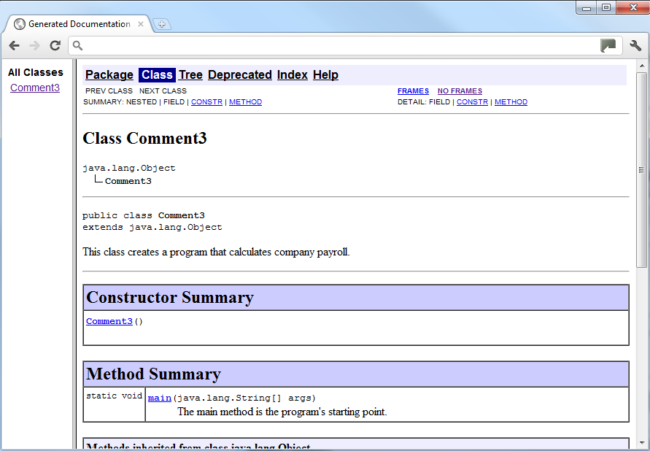
Commenting Code – discussed in detail in Module 5
Example index.html:

Slide 131
Programming Style
Although Java has a strict syntax, whitespace characters are ignored by the compiler.
The Java whitespace characters are:
space
tab
newline
carriage return
form feed
See example: Compact.java

Slide 132
Programming Style - Indentation
Programs should use proper indentation.
Each block of code should be indented a few spaces from its surrounding block.
Two to four spaces are sufficient.
Tab characters should be avoided.
Tabs can vary in size between applications and devices.
Most programming text editors allow the user to replace the tab with spaces.
See example: Readable.java

Slide 133
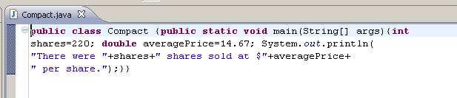
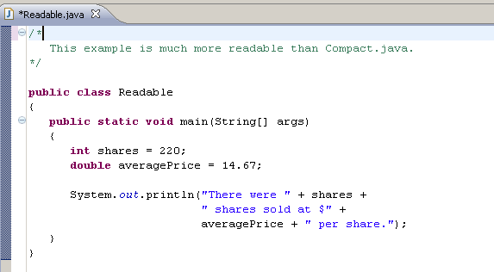

Slide 134
The Scanner Class
To read input from the keyboard we can use the Scanner class.
The Scanner class is defined in java.util, so we will use the following statement at the top of our programs: import java.util.Scanner;

Slide 135
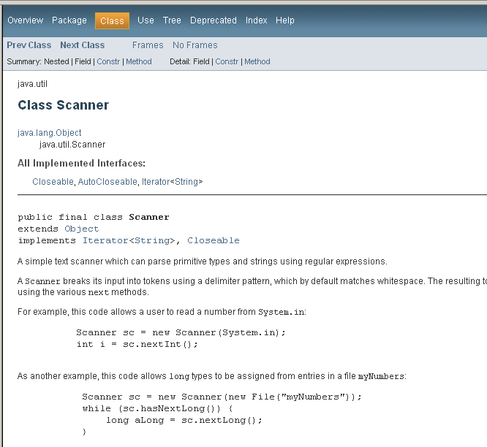

Slide 136
The Scanner Class
Scanner objects work with System.in
To create a Scanner object: Scanner keyboard = new Scanner (System.in);
Scanner class methods are listed in Table 2-18 in the text.
See example: Payroll.java

Slide 137
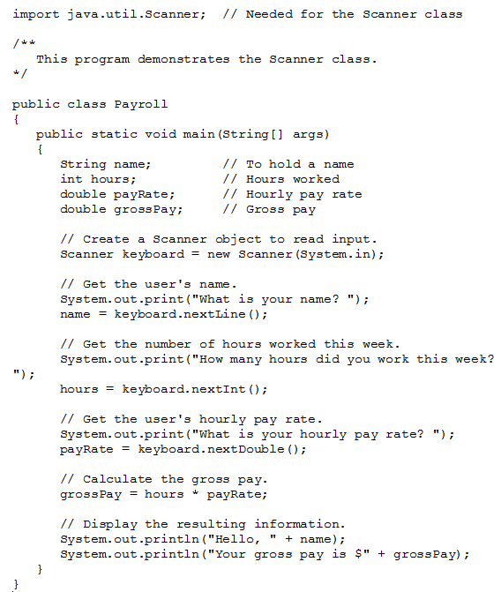

Slide 138
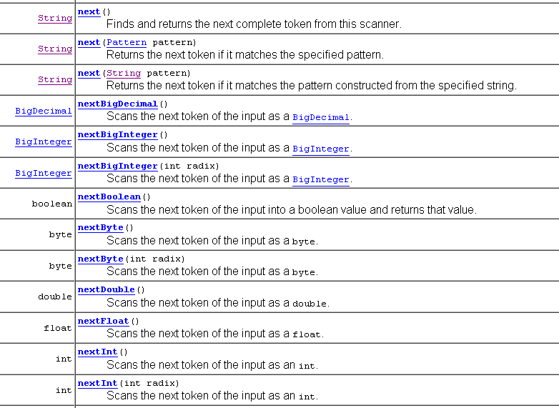
Methods of the Scanner Class

Slide 139
Methods of the Scanner Class
nextDouble reads a double
nextLine reads a line (until user hits Enter)
next reads a word (until any white space)
White space includes space characters, tabs, new line characters

Slide 140
Using a Scanner object
import java.util.Scanner;
public class GasMileage
{
//-----------------------------------------------------------------
// Calculates fuel efficiency based on values entered by the
// user.
//-----------------------------------------------------------------
public static void main (String[] args)
{
int miles;
double gallons, mpg;
Scanner scan = new Scanner (System.in);
System.out.print ("Enter the number of miles: ");
miles = scan.nextInt();
System.out.print ("Enter the gallons of fuel used: ");
gallons = scan.nextDouble();
mpg = miles / gallons;
System.out.println ("Miles Per Gallon: " + mpg);
}
}
TRY IT!

Slide 141
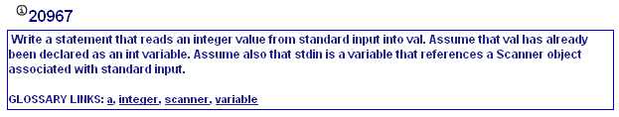
My Programming Lab 2 – 2.13

Slide 142
Good to Know
If there is more than one method in a one class program, make sure that all methods are static and all data is static as well. If the only method in your class is main, and the purpose of the class is to execute main – you can declare the data/variables in main instead of making them static instance variables

Slide 143
import java.util.Scanner;
public class GasMileage
{
//-----------------------------------------------------------------
// Calculates fuel efficiency based on values entered
// by the user.
//-----------------------------------------------------------------
public static int miles;
public static double gallons, mpg;
public static void main (String[] args)
{
Scanner scan = new Scanner (System.in);
System.out.print ("Enter the number of miles: ");
miles = scan.nextInt();
System.out.print ("Enter the gallons of fuel used: ");
gallons = scan.nextDouble();
mpg = miles / gallons;
System.out.println ("Miles Per Gallon: " + mpg);
}
}
import java.util.Scanner;
public class GasMileage
{
//-----------------------------------------------------------------
// Calculates fuel efficiency based on values entered
// by the user.
//-----------------------------------------------------------------
public static void main (String[] args)
{
int miles;
double gallons, mpg;
Scanner scan = new Scanner (System.in);
System.out.print ("Enter the number of miles: ");
miles = scan.nextInt();
System.out.print ("Enter the gallons of fuel used: ");
gallons = scan.nextDouble();
mpg = miles / gallons;
System.out.println ("Miles Per Gallon: " + mpg);
}
}

Slide 144
Good to Know
Scanner class:
If you call the .nextInt() or .nextDouble() to retrieve a numberic from the keyboard and then call a .nextLine() to retrieve a string, it appears as if the .nextLine() gets skipped over. This is because the .nextInt() or .nextDouble() leaves the newline following the numeric on the input stream. Then the .nextLine() looks to retrieve everything up to and including a newline. It finds the newline left by the preceeding method of the scanner and picks that up and places nothing into the variable intended for the string.
Three ways to solve the problem:
Use the .skip() method after the .nextInt() or .nextDouble, however, you need to use a pattern, so I wouldn’t recommend it at this stage
Use a .next() instead of a .nextLine(). This works as long as you don’t intend to pick up a string including whitespaces, i.e. “John Smith”
Use a .nextLine() after the .nextInt() or .nextDouble() to pick up and discard the newline. Then use another .nextLine() to pick up the string
Scanner scan = new Scanner(System.in);
int firstInteger = scan.nextInt();
scan.nextLine(); // picks up and discards the newline
String firstString = scan.nextLine();

Slide 145
Code Coverage
Black-box testing: Test functionality without consideration of internal structure of implementation
White-box testing: Take internal structure into account when designing tests
Test coverage: Measure of how many parts of a program have been tested
Make sure that each part of your program is exercised at least once by one test case E.g., make sure to execute each branch in at least one test case

Slide 146
Code Coverage
Include boundary test cases: Legal values that lie at the boundary of the set of acceptable inputs
Tip: Write first test cases before program is written → gives insight into what program should do

